Slide 1
AUTONOMOUS SAILBOAT FOR WATER QUALITY MONITORING
ASWQM
DR/ Rasha Fathi

Slide 2
Omnia Mahmoud Ismail
Youssef Ahmed Hosny
Mohamed Mohsen Mansour
Waleed Ebrahim Mohamed
Hala Mohamed Hemaida
Group Members

Slide 3
Table of contents
01
02
03
Problem Statement & Project Idea
Monitoring
Mobile Application
04
05
06
Software Layers
HW Implementation
Work Plan and Future Work

Slide 4
01
Problem Statement

Slide 5
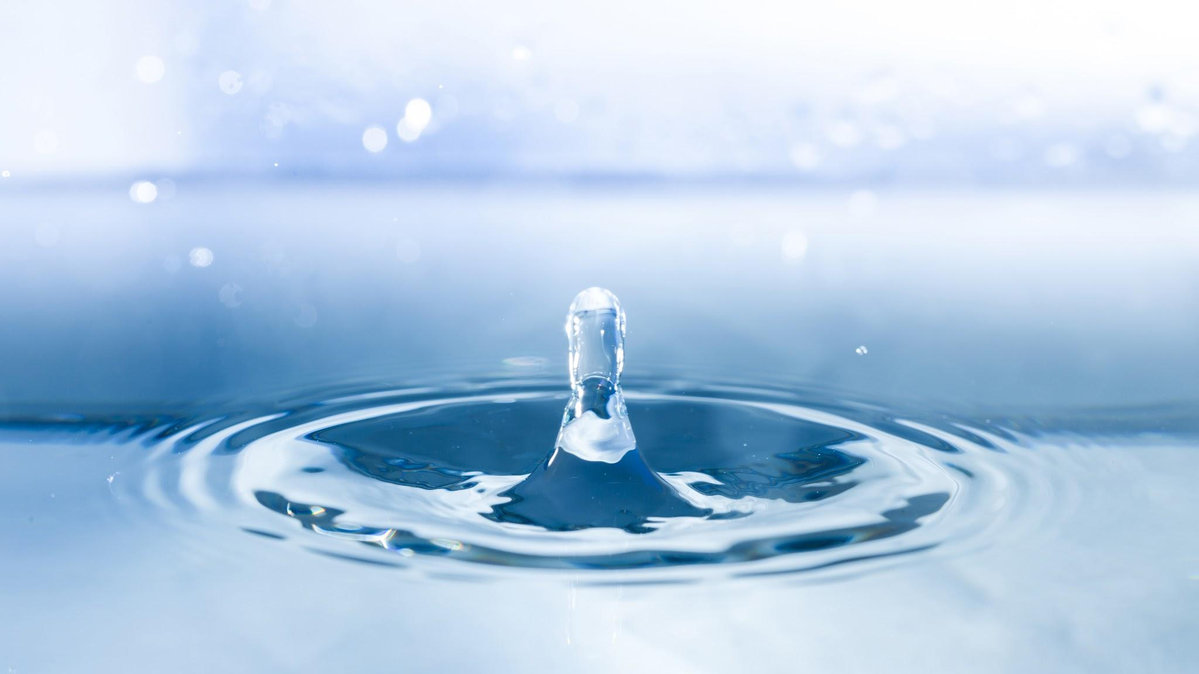
“We never know the worth of water until the well is dry.”
—Thomas Fuller

Slide 6
How is water quality traditionally monitored?
Traditionally, water quality monitoring relies on manual systems of data collection sampling. Sensors are placed at stations to record data, with a sample taken from each and sent to a laboratory for analysis. It is time consuming, costly and inefficient, creating difficult conditions to compare or assess the various water quality parameters.

Slide 7
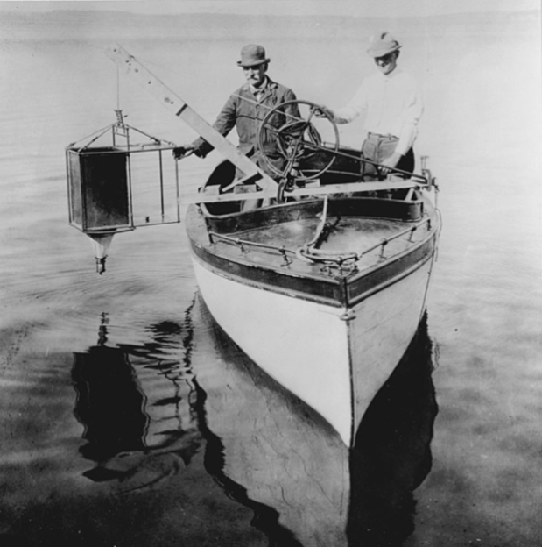
How is water quality traditionally monitored?(cont.)
Another way to monitor called regional approach used to monitor individual lakes and rivers instead of building station, this way takes sample of water and send to laboratory, this way still slow and can’t recognize the emergency quickly.
Fig(1): Edward and Chancy monitor plankton on Madison’s Lake

Slide 8
SO
WHAT IS THE
SOLUTION

Slide 9

01
Project Idea

Slide 10

Main Feachers

Slide 11
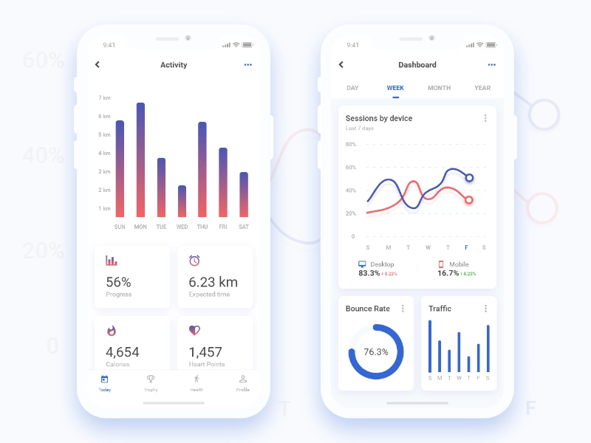
Water Quality Monitoring
Using not expensive sensors to achieve monitoring
Check water quality remotely
Achieve Real Time and Easy Information
Quality Classification According to User’s needs

Slide 12
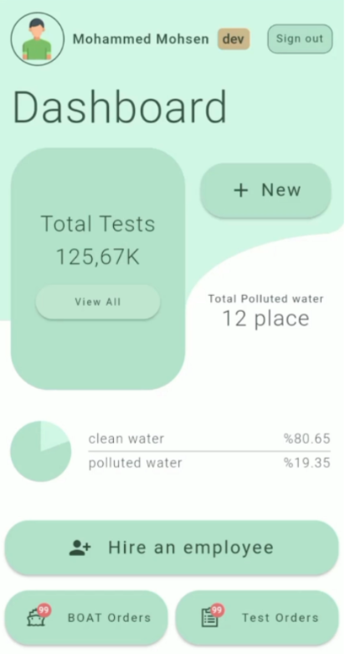
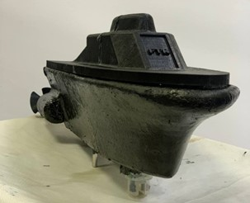
Mobile application
Send location
User who controls the Boat sends new Location to Boat by using Bluetooth module.

Slide 13
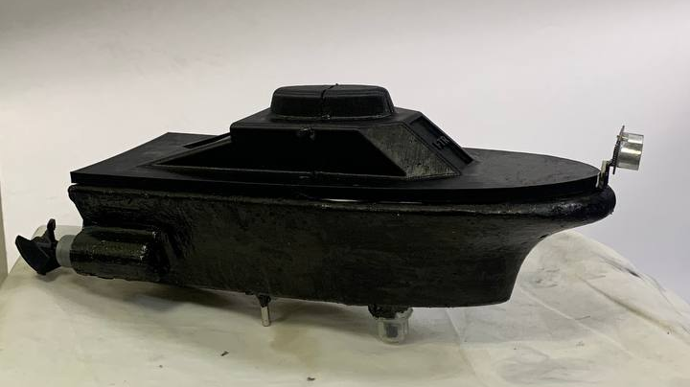
Boat Control
Using MPU and GPS Sensors to Navigate.
Communicating with mobile through Bluetooth Waves.
Autonomous Moving by just one Click.
Holding Water Sensors.
Using PID Algorithm.

Slide 14
02
Monitoring Sensors

Slide 15
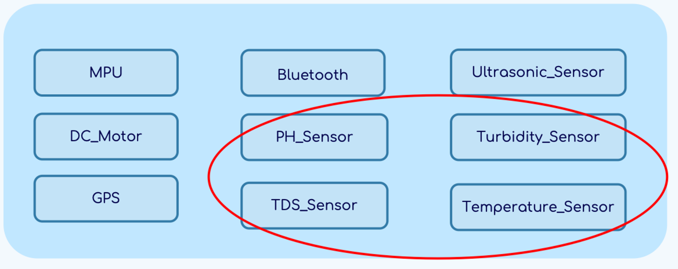
Monitoring Sensors

Slide 16
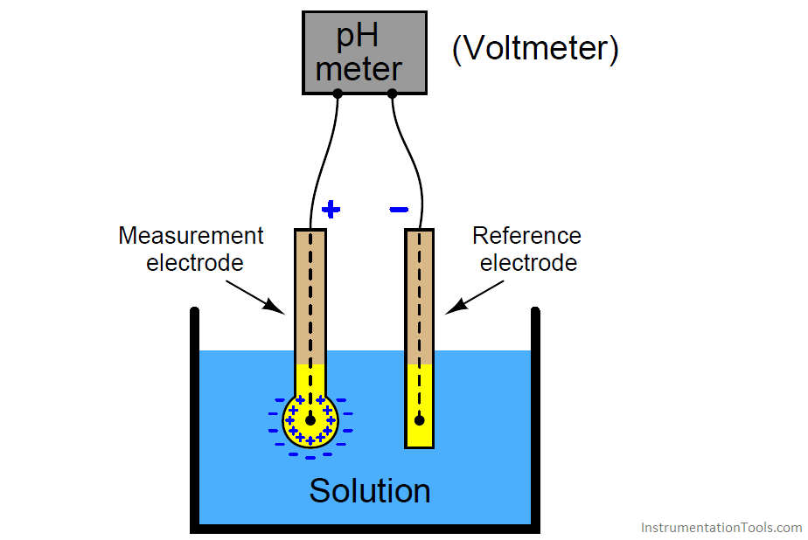
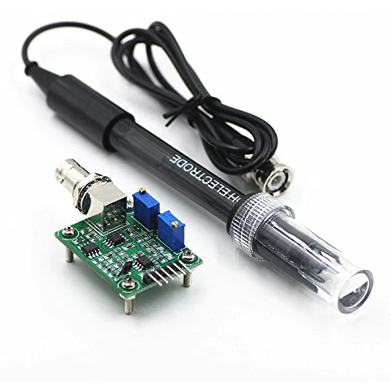
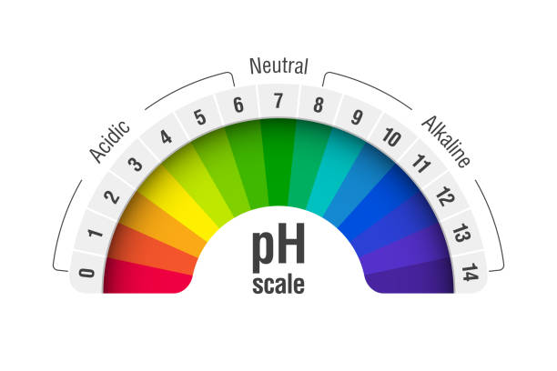
pH Sensor
Role
A pH sensor measures the acidity or alkalinity of the water with a value between 0-14.
How it works?
pH probes contain two electrodes (a sensor electrode and a reference electrode) that measure the hydrogen-ion activity in a solution. The exchange of ions generates a voltage that is measured by the pH meter converting the voltage into a readable pH value.
pH Scale
The range goes from 0 - 14, with 7 being neutral. pH of less than 7 indicate acidity, whereas a pH of greater than 7 indicates a base.
Drinking water pH value is between 6.5- 8.5

Slide 17
Practical Results Comparison
Tested Liquid | Measured Value Range | Ideal Value
Tap Water (neutral) | 6-8 | 7
Water with lemon (acidic) | 3-5 | 3
Water with soap (alkaline) | 11-13 | 12

Slide 18
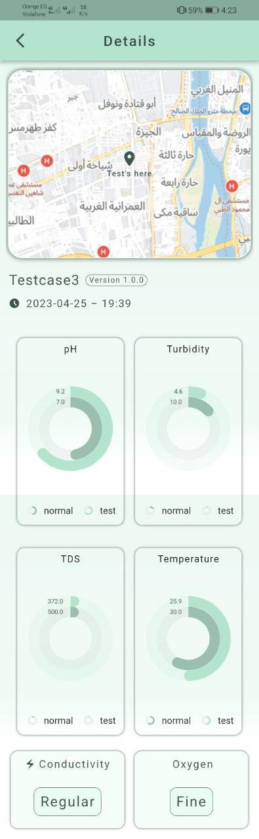
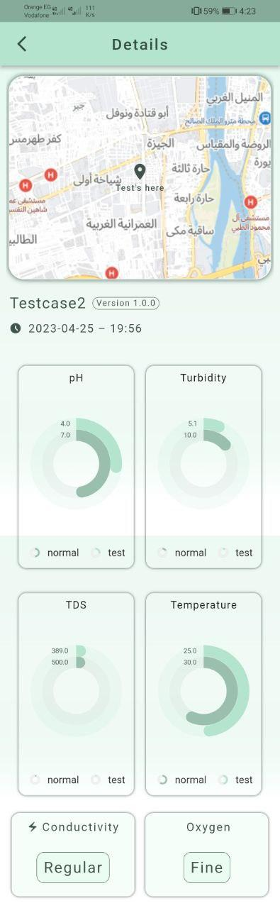
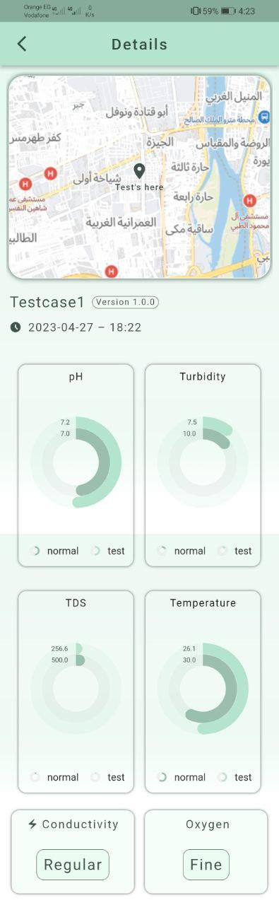
Results from mobile app
Lemon Water
(Acidic)
Tap Water
(Netural)
Soap Water
(Basic)

Slide 19
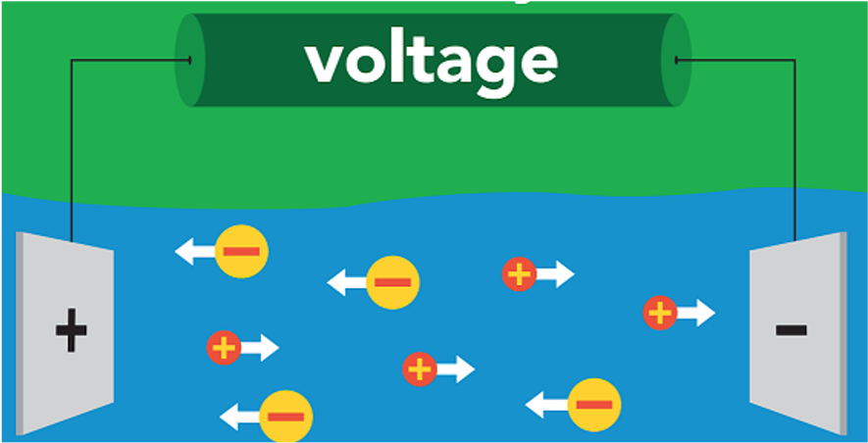
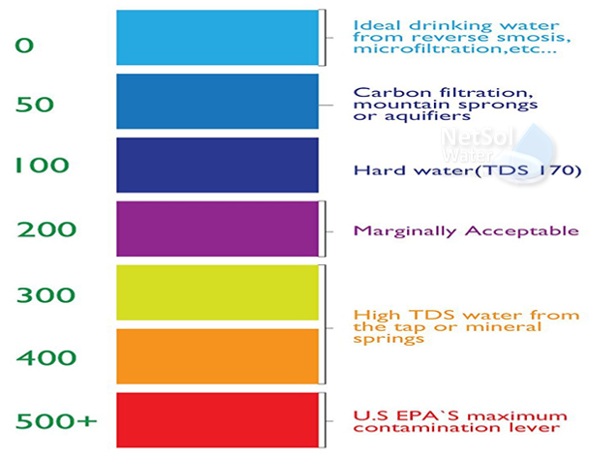
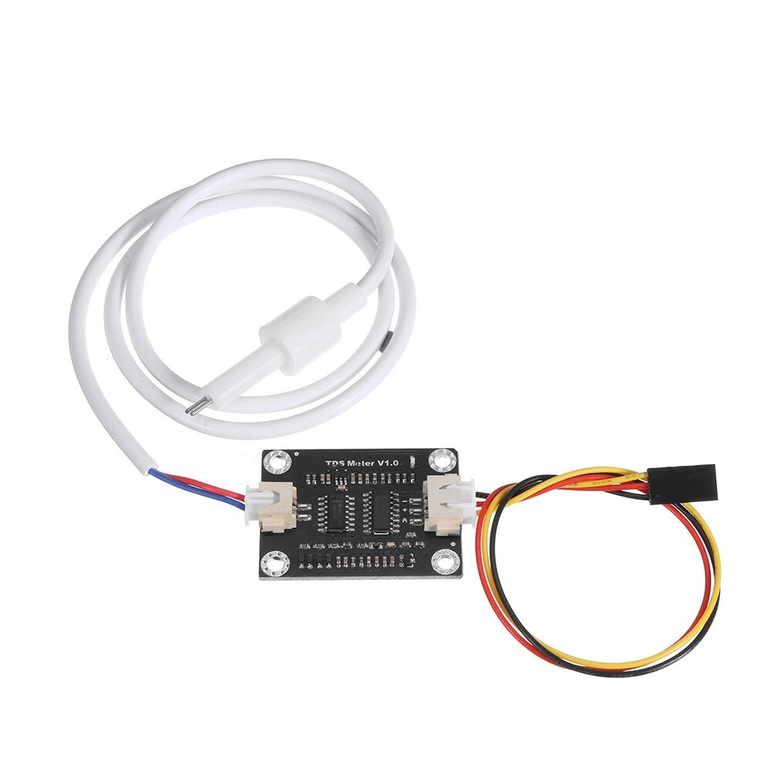
TDS Sensor
Role
TDS (Total Dissolved Solids) indicates how many milligrams of soluble solids are dissolved in one liter of water. In general, the higher the TDS value, the more soluble solids are dissolved in water, and the less clean the water is.
Milligram/ liter is known as Part Per Million ppm.
How it works?
A TDS meter is basically an electrical charge meter which have two electrodes.
If the water contains no soluble materials and is pure, it will not conduct a charge and will have a 0-ppm.
If the water is full of dissolved materials, it will conduct a charge, with the resulting ppm will be proportional to the number of dissolved solids.
TDS in PPM Scale
TDS is measured as a volume of water with the unit ppm. According to the EPA secondary drinking water regulations
Ideal Drinking water has 0 ppm, 500 ppm is contamination lever above it water isn’t drinkable.
Average tap water has 100-400 ppm

Slide 20
Practical Results Comparison
Tested Liquid | Measured Value Range (ppm) | Normal Value Range (ppm)
Tap Water | 200-280 | Less than 500
Water with salt | 1300-1700 | More than 1000
Water with dust & sand | 460-600 | More than 500
Note that the value of ppm increases by stirring & heating water as the solids dissolves more into water.

Slide 21
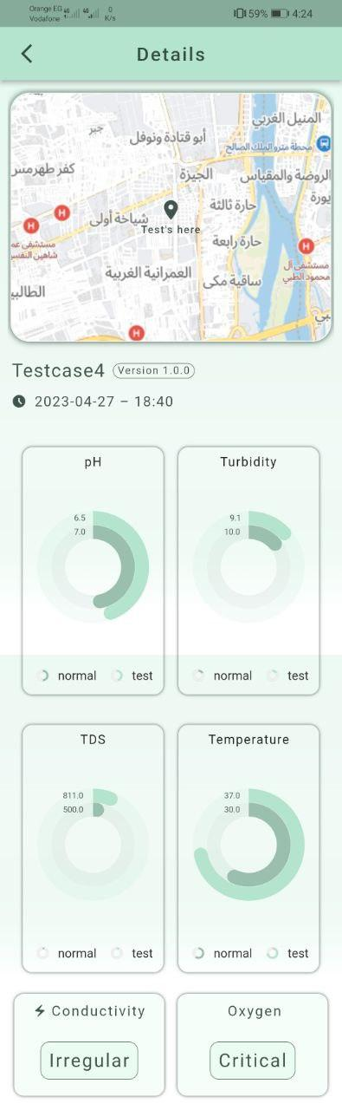
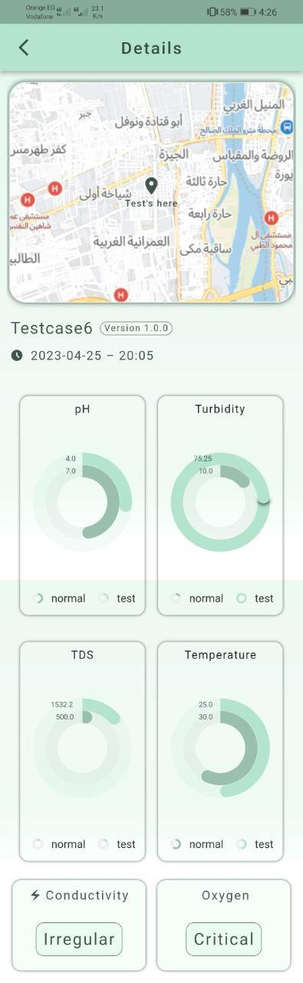
Results from mobile app
Tap Water
Water with dust & sand
Water with salt

Slide 22
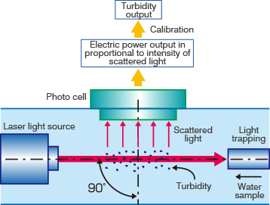
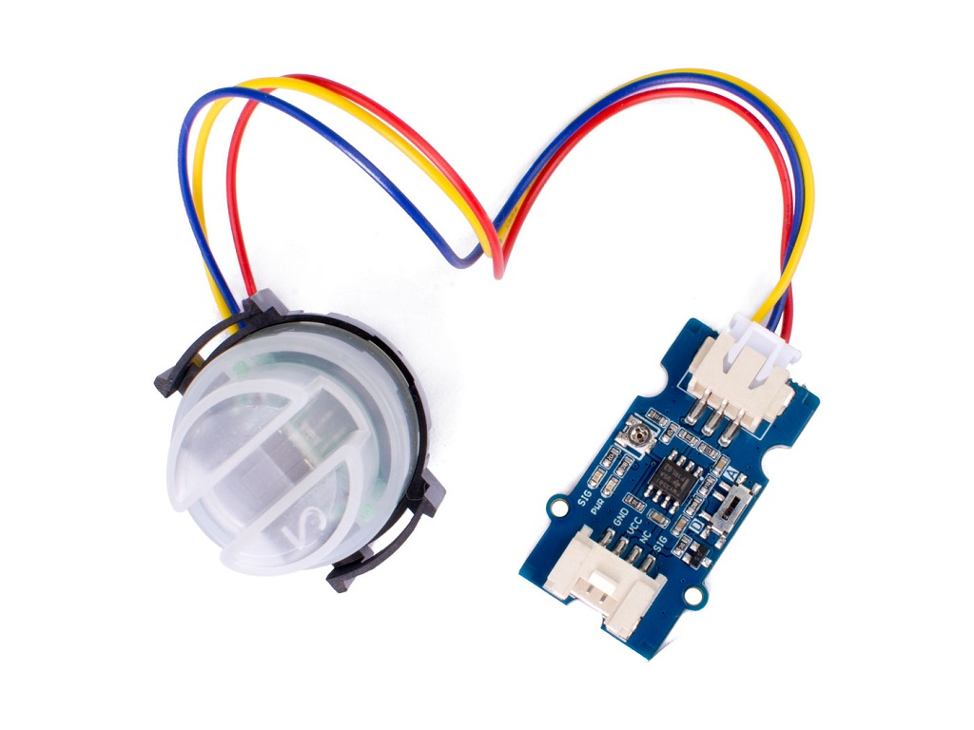
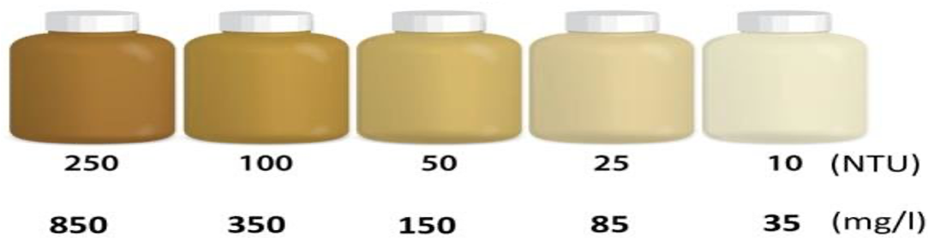
Turbidity Sensor
Role
The turbidity sensor detects water quality by measuring the levels of turbidity, or the opaqueness.
used to measure the turbidity of a fluid or the presence of suspended particles in water.
How it works?
A turbidity probe works by sending a light beam into the water to be tested. This light will then be scattered by any suspended particles. A light detector is placed at a 90 degree angle to the light source, and detects the amount of light that is reflected back at it.
Turbidity NTU Scale
NTU stands for Nephelometric Turbidity unit,.
Ideally Drinking water has <1 NTU,
Contamination lever is 10 NTU, if water exceeds that value it is undrinkable.

Slide 23
Practical Results Comparison
Tested Liquid | Measured Value Range (NTU) | Normal Value Range (NTU)
Tap Water | 6-8 | Less than 10
Water with dust & sand (partially turbid) | 24-30 | 10-50
Water with ink (totally turbid) | 60-80 | More than 50

Slide 24
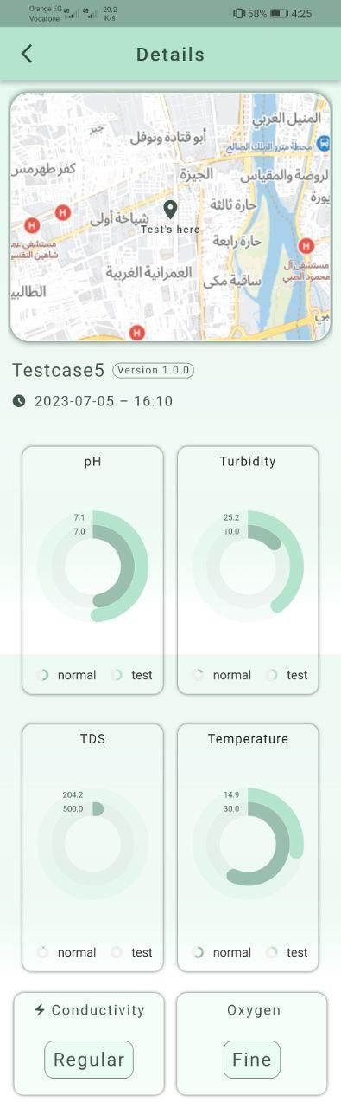
Results from mobile app
Tap Water
(Normal)
Water with dust & sand
(partially turbid)
Water with ink
(totally turbid)

Slide 25
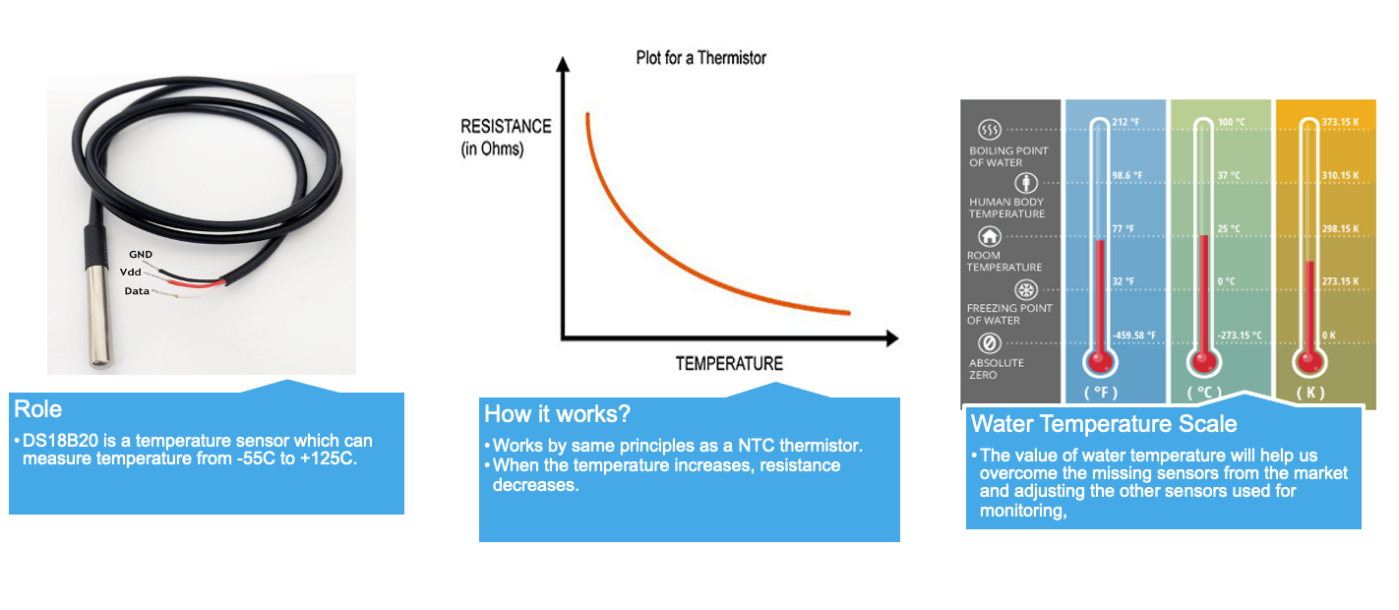
Water Temperature Sensor

Slide 26
Practical Results Comparison
Test Case | Measured Value
Cold water | 10-25℃
Tap water | 25-35 ℃
Warm water | 35-90℃

Slide 27
Results from mobile app
Cold Water
Tap Water
Warm Water

Slide 28
Missing Sensors & How to overcome them
Water Dissolved Oxygen Sensor
Missing Sensor
Combination of TDS & Water Temperature Readings
Our Solution
- As temperature decrease and TDS mg/L(ppm) value decrease the percentage of dissolved oxygen increase.
- If TDS reading between 0-400 ppm & temperature between 5ºC to 30 ºC percentage of oxygen will be between 8 & 15 mg/L.
- Drinking water dissolved oxygen value is between 7.5 & 9 mg/L.
Outcome

Slide 29
Missing Sensors & How to overcome them
Water Conductivity Sensor
Missing Sensor
Combination of TDS & Water Temperature Readings
Our Solution
- The more salts are dissolved in the water, the higher is the value of the electric conductivity.
- TDS (mg/L) = k EC (µS/cm) at 25ºC. Where EC is electric conductivity.
- Drinking water conductivity value is 200 to 800 µS/cm.
Outcome

Slide 30
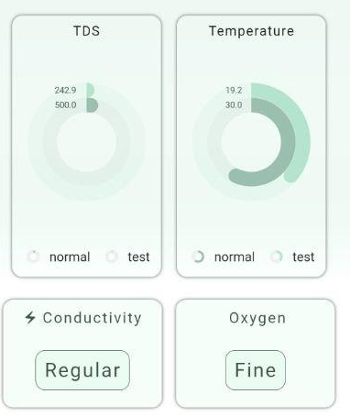
Results from mobile app

Slide 31
03
Mobile Application

Slide 32
Problem Statement
The beauty of this application lies in making facilities available to non-technical users, this application has simplified the complex control and
monitoring processes involved in this project, making it more accessible to
employees and customers alike.

Slide 33
Purpose
The purpose of this solution is to simplify the use of the system for the user by enabling them to send their location using Just One Click. Once the location is received, the system will begin controlling the boat to reach the target destination. After that, the sensors on the boat will start taking readings and transmitting them to the mobile application. The mobile application will then display the sensor readings for the user.

Slide 34
Problem Statement
Another issue that emerged was that only the user would benefit from this testcase. To address this, the mobile application can upload the test cases to the server and provide a user interface for the customer to access the test cases. This way, the customer can also benefit from the test cases stored on the server, leading to greater utilization and value from the system.

Slide 35
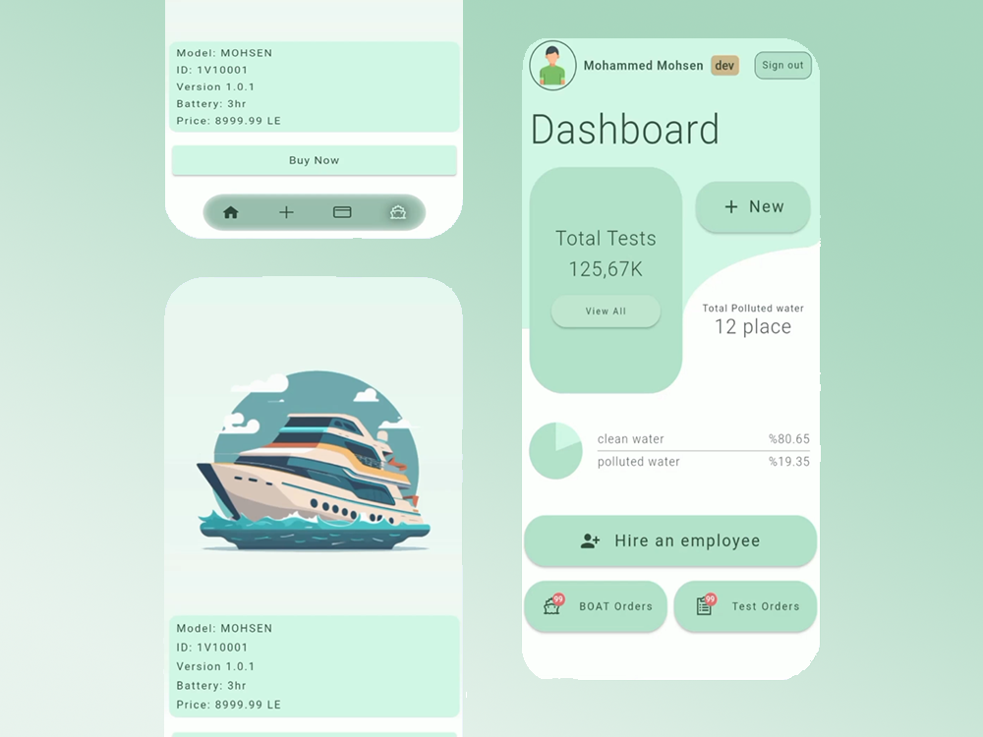

Slide 36
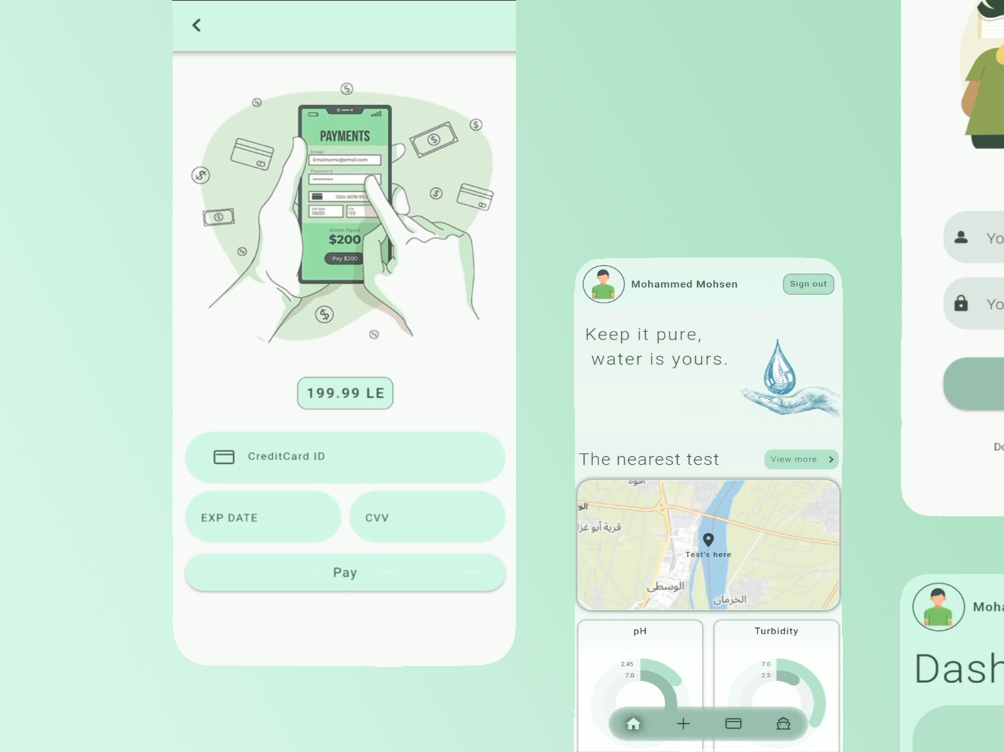

Slide 37
04
HW Implementation

Slide 38
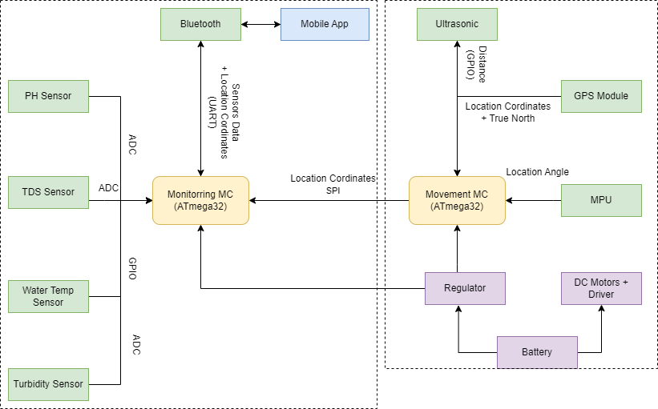
HW Block Diagram

Slide 39
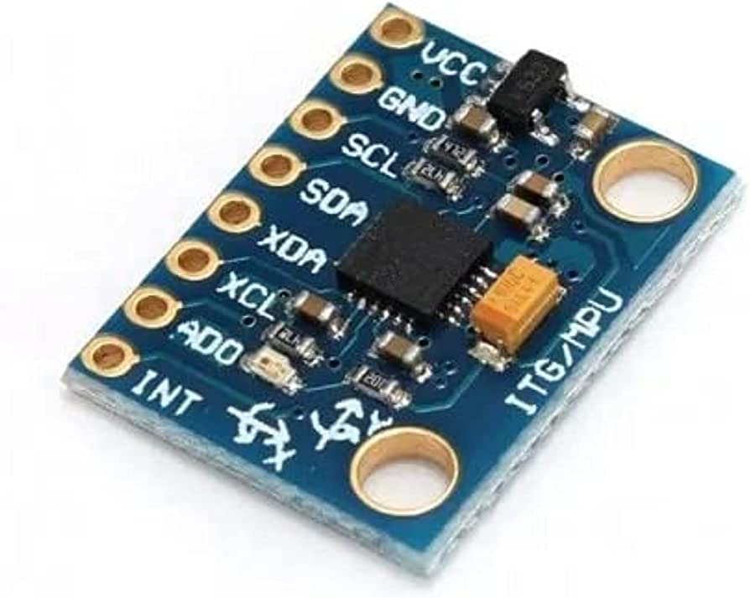
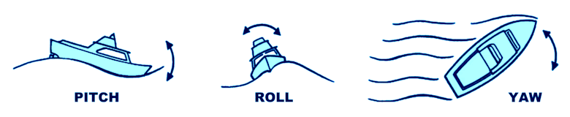
MPU Sensor (Motion Processing Unit)
3 in 1 sensors: ACC, Gyro and Mag.
Gets Yaw, Pitch and Roll angles.
Supply on 3.5-5 V and 3.5 mA.
Real Time Motion Angle.
Internal Measurement Unit (IMU)

Slide 40
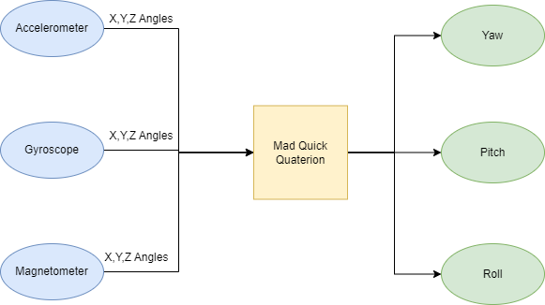
Sensor Fusion

Slide 41
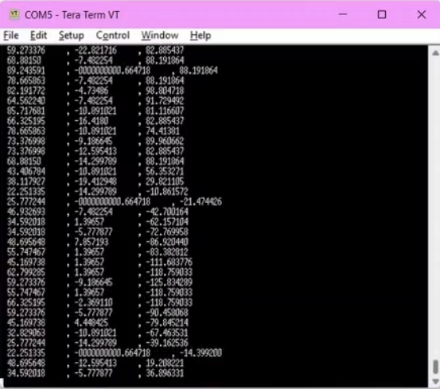
MPU Sensor

Slide 42
05
Software Layers

Slide 43
Software Architecture
MCAL
HAL
APP
RTOS
LIB

Slide 44
MCAL
DIO
ADC
GIE
TIMER0
TIMER1
TIMER2
UART
SPI
I2C

Slide 45
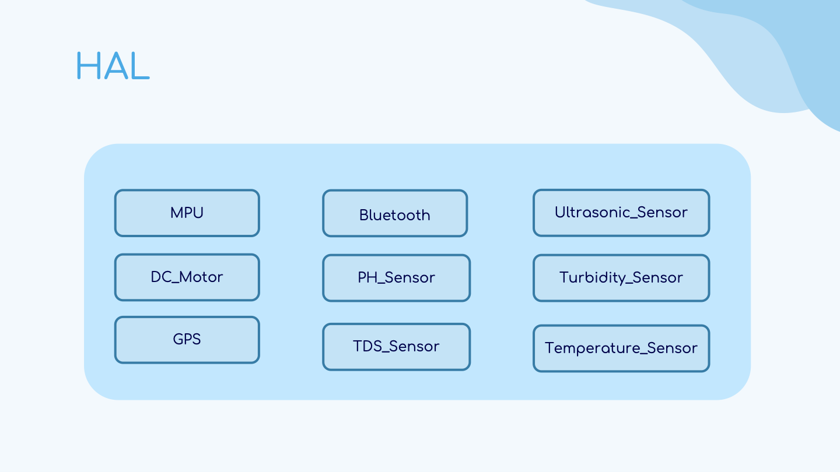
HAL
Bluetooth
MPU
PH_Sensor
DC_Motor
TDS_Sensor
Turbidity_Sensor
Water_Flow
Temperature_Sensor
Depth_Sensor

Slide 46
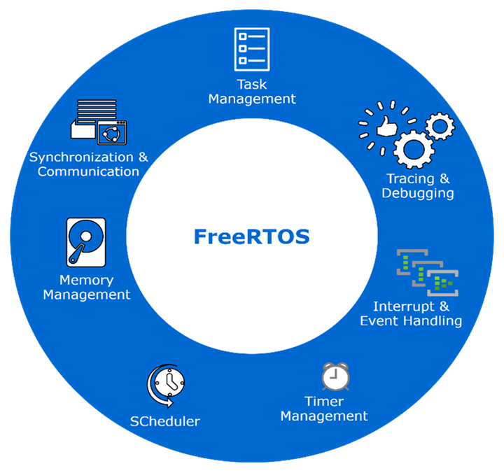
RTOS

Slide 47
Software Block Diagram
PID
MPU_PID
APP
LIB
STD_TYPES
RTOS
DC_Motor
MPU
Bluetooth
HAL
BIT_MATH
PH_Sensor
TDS_Sensor
Turbidity_Sensor
Turbidity_Sensor
Turbidity_Sensor
Turbidity_Sensor
ADC
DIO
GIE
MCAL
Stdutils
TIMER0
TIMER1
TIMER2
UART
SPI
I2C

Slide 48
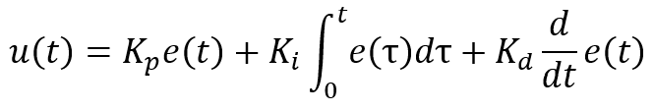
PID
Why we use control algorithm?
A way to influence the process
A way to see how the process behaves
A way to define how we want it to behave
Proportional
+
error
u
MOTOR
Output
Set Point
Σ
Integral
-
Derivative
MPU
MV

Slide 49
Software Architecture
Strengths
Weaknesses
Easy-to-change application.
Easy-to-reuse functions.
Proven and bug free common parts.
Easy-to-port to different hardware systems.
Easy-to-test as it has Hardware Abstraction.
Complexity of architecture
Need good information to be no error designed
Need more time to do it rather than normal code(no software architecture)

Slide 50
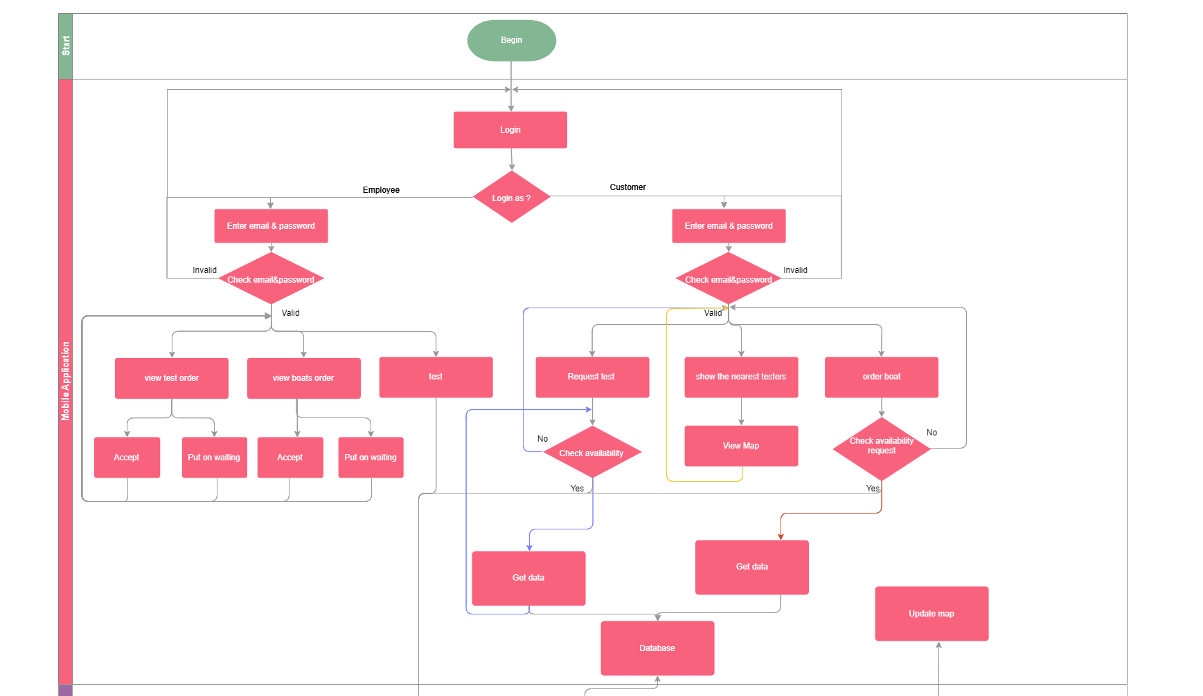
Software Flow Chart

Slide 51
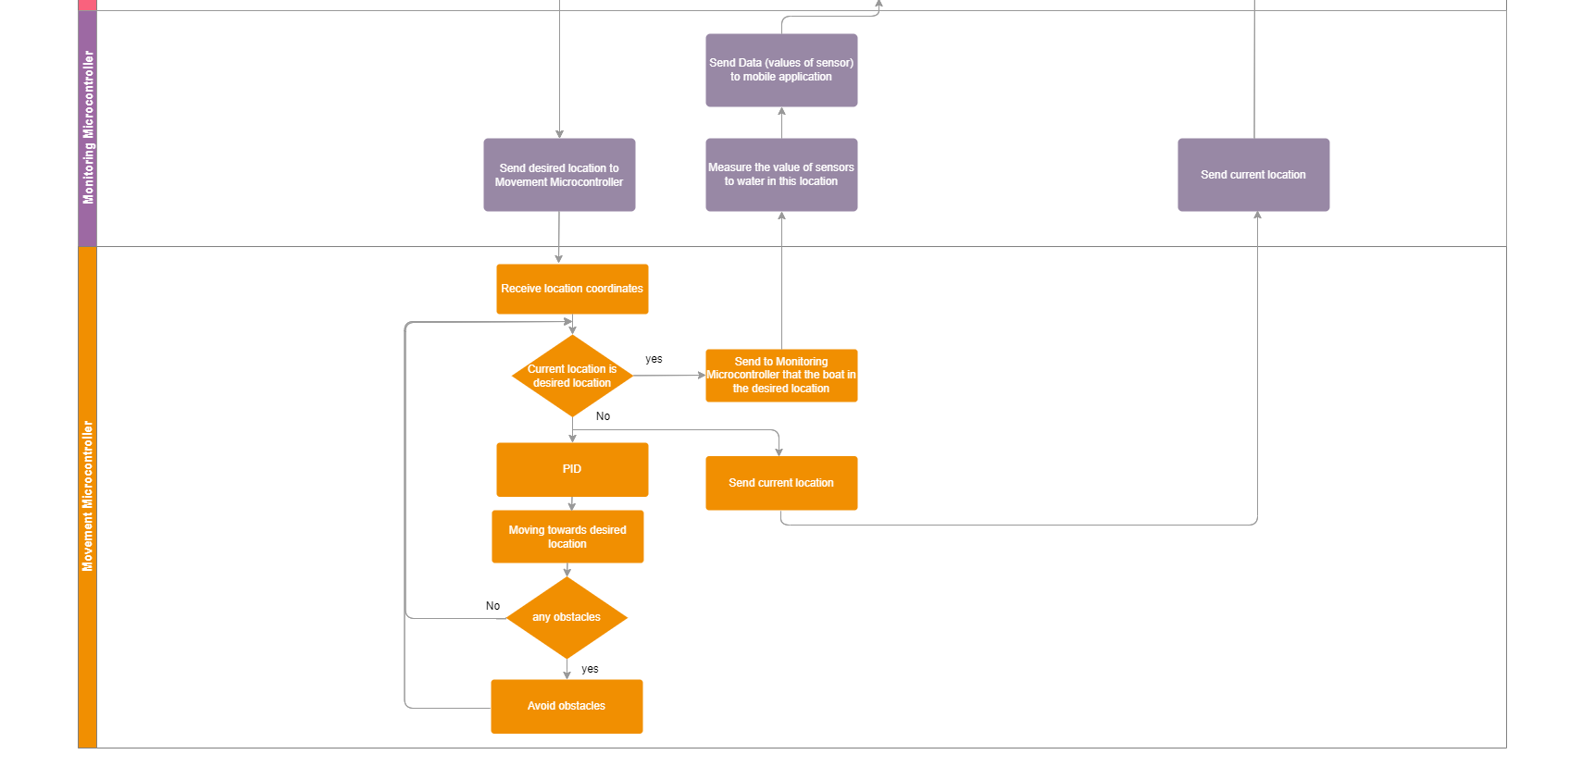
Software Flow Chart

Slide 52
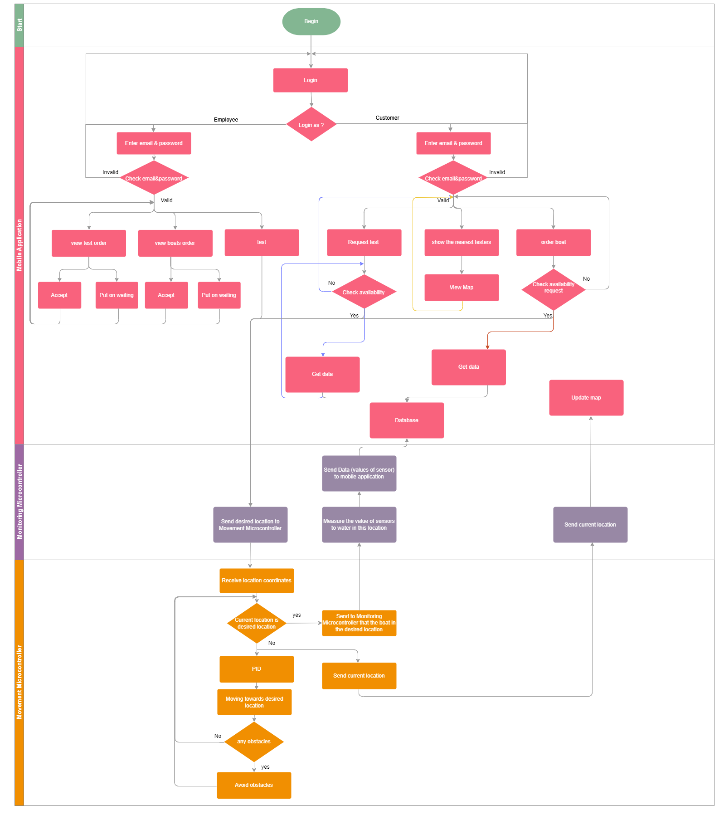
Overall Software Flow Chart

Slide 53
06
Time Plan and Future Work

Slide 54
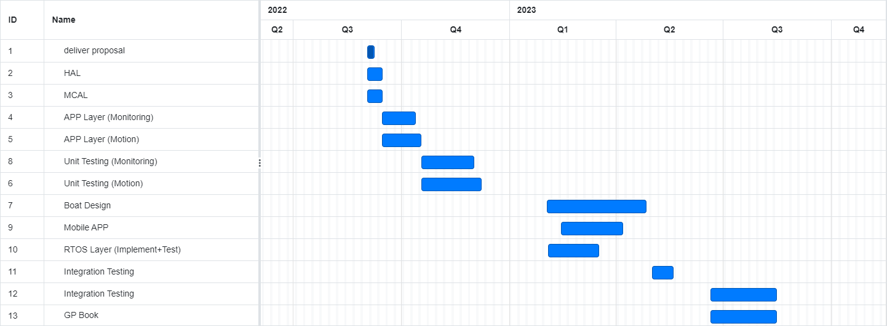
TIME PLAN

Slide 55
FUTURE WORK
Future work will include the following
1. Use satellite Communication(Antenna) instead of bluetooth for further distance.
2. Use Raspberry PI instead of AVR to add AI algorithms to decide either the water can be treated or not.
3. Establishment of Product Line.
4. Adding Ultrasonic waterproof to avoid underwater obstacles.
5. Adding more water quality sensors for more efficient monitoring such as
a.Radiation Sensor b.Nutrient Sensors
c.Water Dissolved Oxygen d.Water Conductivity Sensor
e.Oil and Hydrocarbon Sensors

Slide 56
References
https://water.usgs.gov/owq/WhyMonitorWaterQuality.pdf
https://www.ijsrp.org/research-paper-1118/ijsrp-p8321.pdf
https://eee.guc.edu.eg/announcements/comparaitive_wireless_standards.pdf
https://ieeexplore.ieee.org/abstract/document/7516589
https://www.researchgate.net/publication/320221378_Real-Time_Attitude-Independent_Magnetometer_Bias_Estimation_for_Spinning_Spacecraft
https://www.ncbi.nlm.nih.gov/pmc/articles/PMC5017391/#B1-sensors-16-01226
https://www.ncbi.nlm.nih.gov/pmc/articles/PMC4435162/

Slide 57
Thanks

